Slide 1
Corporate Valuation and Financial Planning
CHAPTER 12
© 2020 Cengage Learning. All Rights Reserved. May not be copied, scanned, or duplicated, in whole or in part, except for use as permitted in a license distributed with a certain product or service or otherwise on a password-protected website for classroom use.

Slide 2
Topics in Chapter
Financial planning
Additional funds needed (AFN) equation
Forecasted financial statements
Operating input data
Financial policy issues
Changing ratios

Slide 3
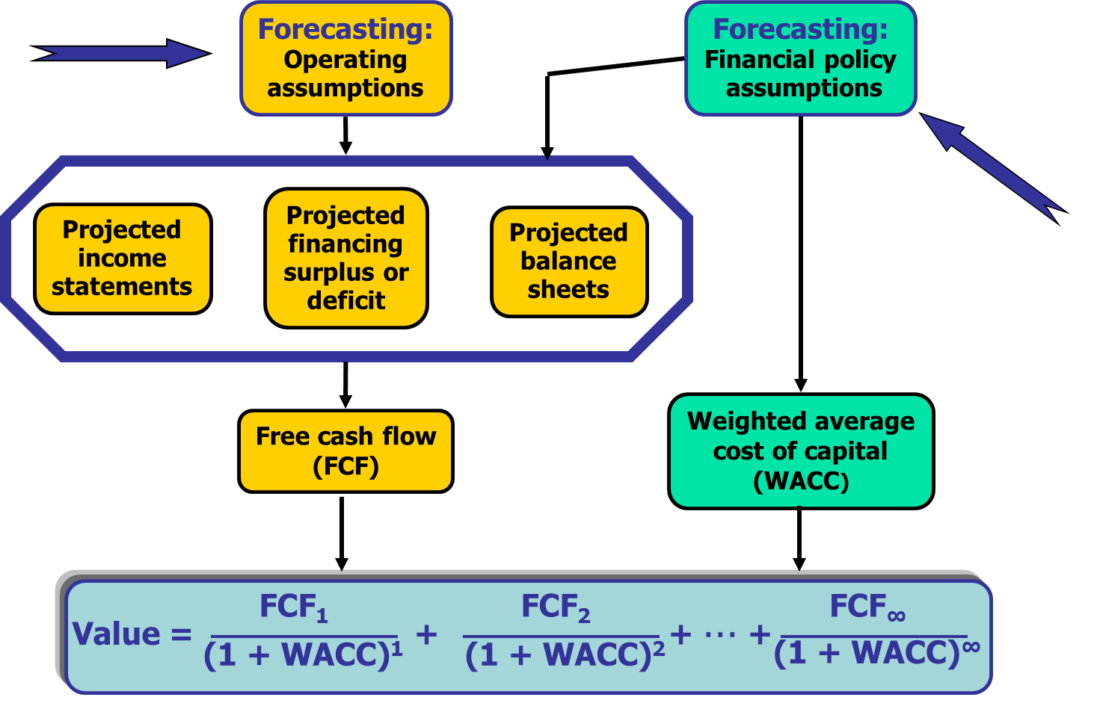
Intrinsic Value: Financial Forecasting

Slide 4
Financial Planning Process
Forecast financial statements under alternative operating plans.
Forecast the free cash flows to determine the estimated intrinsic stock price.
Determine amount of financing needed to support the plan.

Slide 5
Balance Sheet, Hatfield, 12/31/19Planning Process
Assets | 2019 | Liab. & Equity | 2019
Cash | $90 | Accts. pay. & accruals | $1,620
Accts. rec. | 1,260 | Line of credit | 0
Inventories | 1,440 | Total CL | $1,620
Total CA | $2,790 | Long-term debt | 1,800
Net fixed assets | 3,600 | Total liabilities | $3,420
Total assets | $6,390 | Common stock | $2,100
 |  | Retained earnings | 870
 |  | Total common equ. | $2,970
 |  | Total liab. & equity | $6,390

Slide 6
Income Statement, Hatfield, 2019
Income Statement | 2019 | Additional Data | 2019
Sales | $9,000.9 | Dividends | $100
Op. costs (excl. depr.) | 8,100.9 | Add. to RE | $197
Depreciation | 360.0 | Common shares | 50
EBIT | $540.0 | EPS | $5.94
Interest | 144.0 | DPS | $2.00
Pretax earnings | $396.0 | Ending stock price | $41.00
Taxes (40%) | 99.0
Net income | $297.0

Slide 7
Selected Additional Data and Ratios
Operating Data | Hatfield | Ind. | Other Ratios | Hatfield | Ind.
(Op. costs)/Sales | 90% | 88% | Debt/TA | 28.2% | 16.9%
Depr./FA | 10% | 12% | TL/TA | 53.5% | 37.3%
Cash/Sales | 1% | 1% | Times int. earned | 3.8 | 10.2
Receivables/Sales | 14% | 11% | ROA | 4.6% | 9.4%
Inventories/Sales | 16% | 15% | Profit margin (M) | 3.30% | 5.52%
(Fixed assets/Sales | 40% | 32% | Sales/Assets | 1.41 | 1.69
(AP & accr.)/Sales | 18% | 12% | ROE | 10.0% | 7.1%
Tax rate | 25% | 25% | P/E ratio | 6.9 | 16.0
 |  |  | OP ratio | 4.5% | 6.1%
 |  |  | CR ratio | 53.0% | 47.0%
 |  |  | ROIC | 8.5% | 13.0%

Slide 8
Comparison of Hatfield to Industry: Operations
Hatfield has a lower operating profitability (OP) ratio:
4.5% vs. 6.1%
Hatfield has a worse capital requirement CR ratio
53% vs. 47%
Hatfield has a lower ROIC
8.5% vs. 13%
Hatfield’s 8.5% ROIC is less than its 10% WACC
Conclusion: Hatfield’s overall operations are not as good as those of its competitors and Hatfield is not adding value for its investors.

Slide 9
Comparison of Hatfield to Industry: Leverage and Risk
Its debt/TA ratio shows more leverage:
28.2% vs. 16.9%
The TL/TA ratio also shows more leverage:
53.5% vs. 37.3%
The combination of higher interest payments and lower operating profitability cause Hatfield’s times interest earned ratio to be much lower than the industry average.

Slide 10
Comparison of Hatfield to Industry Using DuPont Equation (1 of 3)
M = Profit margin = NI/Sales
TAT = Total asset turnover = Sales/TA
Equity multiplier = TA/Equity
ROE = M × TAT × (Equity multiplier)

Slide 11
Comparison of Hatfield to Industry Using DuPont Equation (2 of 3)
ROE_{Hatfield} = 3.30% × 1.41 × 2.15
= 10.0%.
ROE_{Industry} = 5.60% × 1.69 × 1.59
= 15.05
= 15.1 with no rounding
of inputs

Slide 12
Comparison of Hatfield to Industry Using DuPont Equation (3 of 3)
Profitability ratios lower because of lower operating profits and higher interest expense.
Lower asset management ratios due to high levels of receivables, inventory, and fixed assets.
Higher leverage than industry.

Slide 13
The Additional Funds Needed (AFN) Equation
AFN equation forecasts the additional financing needed by the operating plan.
Basic idea:
Estimate new assets required
Subtract new spontaneous liabilities (i.e., accounts payable and accruals)
Subtract reinvested profit (i.e., net income minus dividends)

Slide 14
AFN (Additional Funds Needed) Equation: Key Assumptions
Operating at full capacity in 2019.
Sales are expected to increase by 10%.
Asset-to-sales ratios remain the same.
Spontaneous-liabilities-to-sales ratio remains the same.
2019 profit margin and payout ratio will be maintained.

Slide 15
Definitions of Variables in AFN
S₀: Most recent sales.
g: Growth rate in sales.
S₁: Projected sales.
ΔS: Increase in sales = g(S₀).
A₀*: Assets required to support sales.
L₀*: Spontaneous liabilities.
A₀*/S₀: Capital intensity ratio.
L₀*/S₀: Spontaneous liabilities ratio.
M: Profit margin (Net income/Sales)
POR: Payout ratio (Dividends/Net income)

Slide 16
Data Needed for AFN Equation
Data for AFN Equation
Growth rate in sales (g) | 11.1%
Sales (S₀) | $9,001
Required assets (A₀*) | $6,390
Spontaneious liabilities (L₀*) | $1,620
Forecasted sales (S₁) | $10,000
Increase in sales (ΔS = gS₀) | $999
Profit margin (M) | 3.30%
Assets/Sales (A₀*/S₀) | 71.0%
Payout ratio (POR) | 33.7%
Spont. Liab./Sales (L₀*/S₀) | 18.0%

Slide 17
Hatfield’s AFN Using AFN Equation
AFN = Required additional assets
– Increase in spontaneous liabilities
– Increase in retained earnings
AFN = (A₀*/S₀)∆S – (L₀*/S₀)∆S – M(S₁)(1 – Payout)
= (0.71)($999) – (0.18)($999) – (0.033)($10,000)(1−0.337)
= $709.26 – $179.84 – $218.79
= $310.6 million

Slide 18
Key Factors in AFN Equation (1 of 2)
Sales growth (g): The higher g is, the larger AFN will be—other things held constant.
Capital intensity ratio (A₀*/S₀): The higher the capital intensity ratio, the larger AFN will be—other things held constant.
Spontaneous-liabilities-to-sales ratio (L₀*/S₀): The higher the firm’s spontaneous liabilities, the smaller AFN will be—other things held constant.

Slide 19
Key Factors in AFN Equation (2 of 2)
Profit margin (Net income/Sales): The higher the profit margin, the smaller AFN will be—other things held constant.
Payout ratio (DPS/EPS): The lower the payout ratio, the smaller AFN will be if other things held constant.

Slide 20
Self-Supporting Growth Rate (1 of 2)
Self-Supporting growth rate is the maximum growth rate the firm could achieve if it had no access to external capital.

Slide 21
Self-Supporting Growth Rate (2 of 2)
If Hatfield’s sales grow less than 4.3%, the firm will not need any external capital.
The firm’s self-supporting growth rate is influenced by the firm’s capital intensity ratio. The more assets the firm requires to achieve a certain sales level, the lower its sustainable growth rate will be.

Slide 22
Forecasted Financial Statements: The Basic Approach
Forecast the operating items (e.g., sales, costs, inventory, etc.).
Choose a preliminary financial policy and use it to forecast the financial items (e.g., long-term debt, interest expense, etc.).
Identify any financing surplus or deficit and eliminate it.
Repeat until satisfied that the plan is achievable and is the best possible.

Slide 23
Forecasting Operating Items
Forecast sales to grow at chosen growth rates.
Forecast many items as a percentage of sales: cash, accounts receivable, inventories, fixed assets, costs (excl. depr.).
Forecast depreciation as a percent of fixed assets.

Slide 24
Initial Operating Assumptions for the No Change Scenario
Operating ratios remain unchanged from values in most recent year.
Sales will grow by 11.1%, 8%, 5%, and 5% for the next four years.
The target weighted average cost of capital (WACC) is 10%.

Slide 25
Assumptions
 | Actual | Forecast | Forecast | Forecast | Forecast
Inputs | 2018 | 2019 | 2020 | 2021 | 2022
Sales growth rate: |  | 11.1% | 8% | 5% | 5%
(Op. costs)/Sales: | 90.00% | 90.0% | 90% | 90% | 90%
Depr./FA | 10.00% | 10% | 10% | 10% | 10%
Cash/Sales: | 1.00% | 1% | 1% | 1% | 1%
(Acct. rec.)/Sales | 14.00% | 14% | 14% | 14% | 14%
Inv./Sales: | 16.00% | 16% | 16% | 16% | 16%
FA/Sales: | 40.00% | 40% | 40% | 40% | 40%
(AP& accr.)/ Sales: | 18.00% | 18% | 18% | 18% | 18%
Tax rate: | 25.00% | 25% | 25% | 25% | 25%

Slide 26
Examples of Forecasting Items
Sales₂₀₁₉ = Sales₂₀₁₈(1 + g_{2018,2019} ) = $9,000.9(1+0.111) = $10,000.
Inventories₂₀₁₉ = Sales₂₀₁₉(Inv/Sales) = $10,000(0.16) = $1,600

Slide 27
Forecasted Operating Items
Scenario: No Change | Actual | Forecast | Forecast | Forecast | Forecast
 | 2019 | 2020 | 2021 | 2022 | 2023
Net sales | $9,000.9 | $10,000 | $10,800 | $11,340 | $11,907
Op. costs (excl. depr.) | $8,100.9 | $9,000 | $9,720 | $10,206 | $10,716
Depreciation | $360.0 | $400 | $432 | $454 | $476
EBIT | $540.0 | $600 | $648 | $680 | $714
Cash | $90.0 | $100 | $108 | $113 | $119
Accounts receivable | $1,260.0 | $1,400 | $1,512 | $1,588 | $1,667
Inventories | $1,440.0 | $1,600 | $1,728 | $1,814 | $1,905
Net fixed assets | $3,600.0 | $4,000 | $4,320 | $4,536 | $4,763
Accts. pay. & accruals | $1,620.0 | $1,800 | $1,944 | $2,041 | $2,143

Slide 28
Calculate Forecasted FCF (1 of 2)
NOPAT = EBIT(1-T)
NOWC = (Cash + accounts receivable + inventories) − (Accounts payable & accruals)
Total operating capital = NOWC + Net fixed assets
FCF = NOPAT − Change in total operating capital
ROIC = NOPAT/(Total operating capital)

Slide 29
Calculate Forecasted FCF (2 of 2)
Scenario: No Change | Actual | Forecast | Forecast | Forecast | Forecast
 | 2019 | 2020 | 2021 | 2022 | 2023
NOPAT | $405 | $450 | $486 | $510 | $536
NOWC | $1,170 | $1,300 | $1,404 | $1,474 | $1,548
Total op. capital | $4,770 | $5,300 | $5,724 | $6,010 | $6,311
FCF |  | -$80 | $62 | $224 | $235
Growth in FCF |  |  | -177.5% | 261.5% | 5.0%
ROIC | 8.5% | 8.5% | 8.5% | 8.5% | 8.5%
FCF is negative in 2020.
ROIC of 8.5% is less than WACC of 10%--not good!

Slide 30
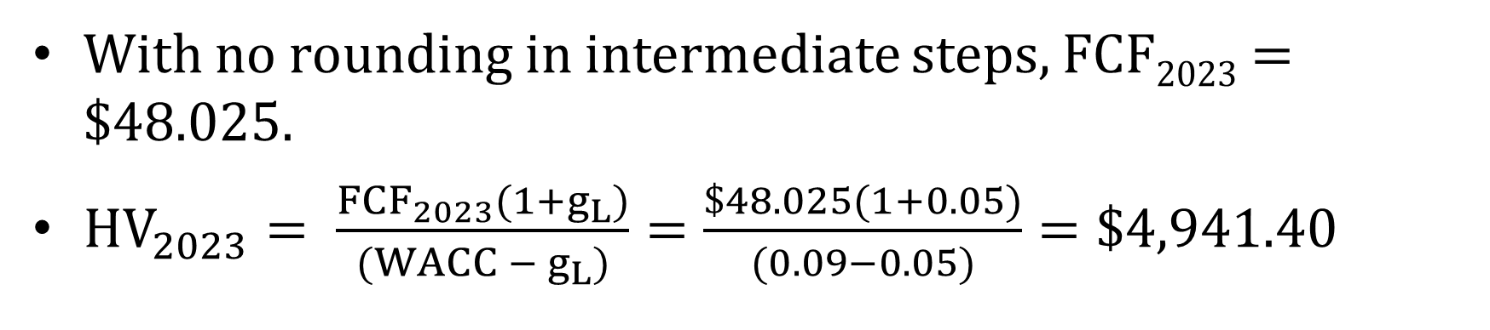
Estimated Intrinsic Value
With no rounding in intermediate steps, FCF₂₀₂₃ = $48.025.
${HV}_{2023}= \frac{{FCF}_{2023}(1+g_{L})}{(WACC − g_{L})}=\frac{\$48.025(1+0.05)}{(0.09−0.05)}=\$4,941.40$
Scenario: No Change
Horizon Value: |  | Value of operations | $3,682
 |  | + ST investments | $0
HV₂₀₂₃ = | $4,941 | Est. total intrinsic value | $3,682
 |  | − All debt | $1,882
Value of Operations: |  | − Preferred stock | $0
Present value of HV | $3,375 | Est. intrinsic value of equity | $1,882
+ Present value of FCF | $307 | ÷ Number of shares | 50
Value of operations = | $3,682 | Est. intrinsic stock price = | $37.60

Slide 31
Estimated Intrinsic Stock Price versus Market Price
Stock price:
Estimated price = $37.65 (if no rounding in intermediate steps)
Actual price =$41
Difference of −8.2%:
37.65/$41 – 1 = −3%
Is this a big difference of small difference?
Market expects improved performance.

Slide 32
Forecasted Financial Statements: The Balance Sheet and Income Statement
Start with the operating items on the balance sheet and income statement that were previously forecast.
Implement the preliminary financial policy chosen by the company:
Regular dividends will grow by 10%.
No additional long-term debt or common stock will be issued.
The interest rate on all debt is 8%.
Interest expense for long-term debt is based on the average balance during the year.

Slide 33
Identify and Eliminate the Financing Deficit or Surplus
After implementing the operating plan and the preliminary financing policy, it would be unusual for the additional financing to exactly match the additional assets needed for the operating plan :
Financing deficit if additional financing is less than additional assets.
Financing surplus if additional financing is greater than additional assets.
Eliminate the financing deficit or surplus:
If deficit, draw on a line of credit. The line of credit would be tapped on the last day of the year, so it would create no additional interest expenses for that year.
If surplus, eliminate it by paying a special dividend.

Slide 34
Preliminary Income Statement
 | 2019 | Input | Basis for 2020 Forecast | 2020
Sales | $9,000.9 | 1.111 | × 2019 Sales | $10,000
Op. costs (excl. depr.) | 8,100.9 | 90% | × 2020 Sales | 9,000
Depreciation | 360.0 | 10% | × 2020 Net fixed assets | 400
EBIT | $ 540.0 |  |  | $ 600.0
Less: Interest on LTD | 144.0 | 8% | × Avg bonds | 144
Interest on LOC | 0 | 8% | × Beginning LOC
Pretax earnings | $ 396.0 |  |  | $ 456
Taxes (40%) | 99.0 | 25% | × Pretax earnings | 114
Net income | $ 297.0 |  |  | $ 342
Regular dividends | $100.0 | 110% | × 2017 Dividend | $110
Special dividends | $0.0 |  | Pay if financing surplus
Addition to RE | $197.0 |  | Net income – Dividends | $232

Slide 35
Preliminary Balance Sheets
Assets | 2019 | Input | Basis for 2020 Forecast | 2020
Cash | $ 90 | 1% | × 2020 Sales | $ 100
Accts. rec. | 1,260 | 14% | × 2020 Sales | 1,400
Inventories | 1,440 | 16% | × 2020 Sales | 1,600
Total CA | $2,790 |  |  | $3,100
Net fixed assets | 3,600 | 40% | × 2020 Sales | 4,000
Total assets | $6,390 |  |  | $7,100
Liabilities and equity
Accts. pay. & accruals | $1,620 | 18% | × 2020 Sales | $1,800
Line of credit | 0 |  | Add LOC if fin. deficit
Total CL | $1,620 |  |  | $1,800
Long-term debt | 1,800 |  | No Change | 1,800
Total liabilities | $3,420 |  |  | $3,600
Common stock | $2,100 |  | No Change | $2,100
Retained earnings | $ 870 |  | Old RE + Add. to RE | 1,102
Total common equity | $2,970 |  |  | $3,202
Total liabs. & equity | $6,390 |  |  | $6,802
 |  |  | Check: TA − TL & Equ. | $298

Slide 36
Identify and Eliminate Financing Deficit or Surplus (1 of 2)
Increase in spontaneous liabilities (accts. pay. and accruals) | $180
+ Increase in planned long-term debt and common stock | $0
− Previous line of credit* | $0
+ Net income minus regular common dividends | $232
Increase in financing | $412
− Increase in total assets | $710
Amount of deficit or surplus financing: | −$298
If deficit (negative), draw on line of credit | $298
If surplus (positive), pay special dividend | $0

Slide 37
Updated Balance Sheets
Assets | 2019 | Input | Basis for 2020 Forecast | 2020
Cash | $ 90 | 1% | × 2020 Sales | $ 100
Accts. rec. | 1,260 | 14% | × 2020 Sales | 1,400
Inventories | 1,440 | 16% | × 2020 Sales | 1,600
Total CA | $2,790 |  |  | $3,100
Net fixed assets | 3,600 | 40% | × 2020 Sales | 4,000
Total assets | $6,390 |  |  | $7,100
Liabilities and equity
Accts. pay. & accruals | $1,620 | 18% | × 2020 Sales | $1,800
Line of credit | 0 |  | Add LOC if fin. deficit | 298
Total CL | $1,620 |  |  | $2,098
Long-term debt | 1,800 |  | No Change | 1,800
Total liabilities | $3,420 |  |  | $3,898
Common stock | $2,100 |  | No Change | $2,100
Retained earnings | $ 870 |  | Old RE + Add. to RE | 1,102
Total common equity | $2,970 |  |  | $3,202
Total liabs. & equity | $6,390 |  |  | $7,100
 |  |  | Check: TA − TL & Equ. | $0

Slide 38
Update Income Statements?
No. Preliminary income statements will not change because of assumption that line of credit was added at end of year.
What would happen if the line of credit was added earlier in year? See next slide.

Slide 39
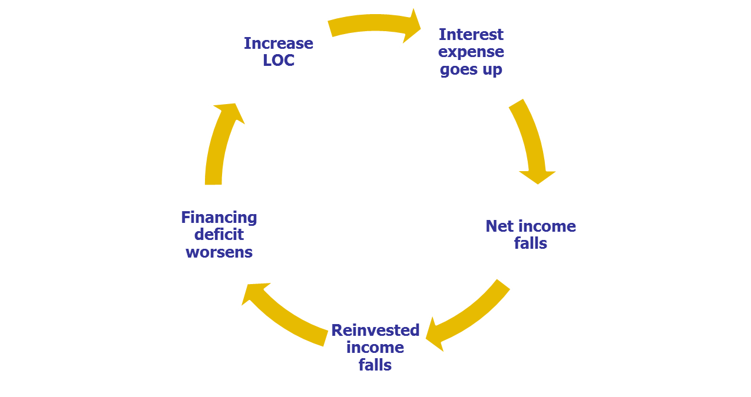
Impact of Adding Line of Credit During Year Instead of at End of Year—Financing Feedback!

Slide 40
Financing Feedback-Solutions
Repeat process, iterate until balance sheet balances.
Manually.
Using Excel’ Iteration feature.
But Excel sometimes breaks down and fails.
Use Excel Goal Seek to find amount of LOC that makes balance sheets balance.
Use simple formula to adjust the LOC so that the adjusted amount of financing incorporates financing feedback; see the tab 2. FinFeedback in the file Ch12 Mini Case.xlsx or see CFO Model in Ch12 Tool Kit.xlsx for examples.

Slide 41
Alternatives to Drawing on LOC
Cut dividends.
Add long-term debt.
Issue common stock.
Cut back on growth in operating plan.
Improve operating plan.
Financial planning is an iterative process—if plan isn’t acceptable, then the company can make changes.

Slide 42
Planned Improvements
Reduce operating costs (excluding depreciation)/sales to 89.4%
Cost: $40
Reduce inventories/sales = 14%
Cost: $10
Reduce next fixed assets/sales = 38%
Cost: $20
Total costs: $50

Slide 43
Improvements in Operating Plan (Ignoring costs of improvements)
Scenario: Improve | Actual | Forecast | Forecast | Forecast | Forecast
 | 2019 | 2020 | 2021 | 2022 | 2023
NOPAT | $90 | $510 | $551 | $578 | $607
NOWC | $620 | $1,100 | $1,188 | $1,247 | $1,310
Total op. capital | $1,120 | $4,900 | $5,292 | $5,557 | $5,834
FCF |  | $380 | $159 | $314 | $329
Growth in FCF |  |  | -58.2% | 97.6% | 5.0%
ROIC | 8.0% | 10.4% | 10.4% | 10.4% | 10.4%
New ROIC of 10.4% is higher than WACC of 10%--big improvement.

Slide 44
New Estimated Intrinsic Value (Ignoring cost of improvements)
Scenario: Improve
Horizon Value: |  | Value of operations | $1,314
 |  | + ST investments | $0
HV₂₀₂₃ = | $1,598 | Est. total intrinsic value | $1,314
 |  | − All debt | $500
Value of Operations: |  | − Preferred stock | $0
Present value of HV | $1,132 | Est. intrinsic value of equity | $814
+ Present value of FCF | $182 | ÷ Number of shares | 10
Value of operations = | $1,314 | Est. intrinsic stock price = | $81.37
Improvement in value of operations: $1,314 − $958 = $356
Cost of improvements = $50
Company should make improvements.

Slide 45
New Income Statement Reflecting Improvements
 | 2019 | Input | Basis for 2020 Forecast | 2020
Sales | $9,000.9 | 1.111 | × 2019 Sales | $10,000
Op. costs (excl. depr.) | 8,100.9 | 89.4% | × 2020 Sales | 8,940
Depreciation | 360.0 | 10% | × 2020 Net fixed assets | 380
EBIT | $ 540.0 |  |  | $ 680
Less: Interest on LTD | 144.0 | 8% | × Avg bonds | 144
Interest on LOC | 0 | 8% | × Beginning LOC | 0
Pretax earnings | $ 396.0 |  |  | $ 536
Taxes (40%) | 99.0 | 25% | × Pretax earnings | 134
Net income | $ 297.0 |  |  | $ 402
Regular dividends | $100.0 | 110% | × 2017 Dividend | $110
Special dividends | $0.0 |  | Pay if financing surplus | $162
Addition to RE | $197.0 |  | Net income – Dividends | $130

Slide 46
New Balance Sheets Reflecting Improvements
Assets | 2019 | Input | Basis for 2020 Forecast | 2020
Cash | $ 90 | 1% | × 2020 Sales | $ 100
Accts. rec. | 1,260 | 14% | × 2020 Sales | 1,400
Inventories | 1,440 | 14% | × 2020 Sales | 1,400
Total CA | $ 2,790 |  |  | $ 2,900
Net fixed assets | 3,600 | 38% | × 2020 Sales | 3,800
Total assets | $ 6,390 |  |  | $ 6,700
Liabilities and equity
Accts. pay. & accruals | $ 1,620 | 4% | × 2020 Sales | $ 1,800
Line of credit | - |  | Add LOC if fin. deficit | -
Total CL | $ 1,620 |  |  | $ 1,800
Long-term debt | 1,800 |  | No Change | 1,800
Total liabilities | $ 3,420 |  |  | $ 3,600
Common stock | $ 2,100 |  | No Change | 2,100
Retained earnings | 870 |  | Old RE + Add. to RE | 1,000
Total common equity | $ 2,970 |  |  | $ 3,100
Total liabs. & equity | $ 6,390 |  |  | $ 6,700
 |  |  | Check: TA − TL & Equ. | $0

Slide 47
Identify and Eliminate Financing Deficit or Surplus (2 of 2)
Increase in spontaneous liabilities (accts. pay. and accruals) | $180
+ Increase in planned long-term debt and common stock | $0
− Previous line of credit* | $0
+ Net income minus regular common dividends | $292
Increase in financing | $472
− Increase in total assets | $310
Amount of deficit or surplus financing: | $162
If deficit (negative), draw on line of credit | $0
If surplus (positive), pay special dividend | $180

Slide 48
Net Effect of Improvement Plan
 | Improve | No Change | Net Change in Value
Value of operations | $5,662 | $3,683 | $1,980
Cost of Improvement | -$70 |  | -$70
Total value | $5,592 | $3,683 | $1,910

Slide 49
Alternatives to Paying Special Dividend
Repurchase stock
Repay debt
Purchase marketable securities

Slide 50
Modifying the Forecasting Model
Multi-year projections of financial statements.
Maintain target capital structure each year.
For examples, see Ch12 Tool Kit.xlsx and look at the worksheet CFO Model.

Slide 51
Variations on the Percent of Sales
In some situations, it might not be appropriate to model operating ratios as a percent of sales:
Economies of scale
Nonlinearity
Lumpy assets acquisitions.
See following slides.

Slide 52
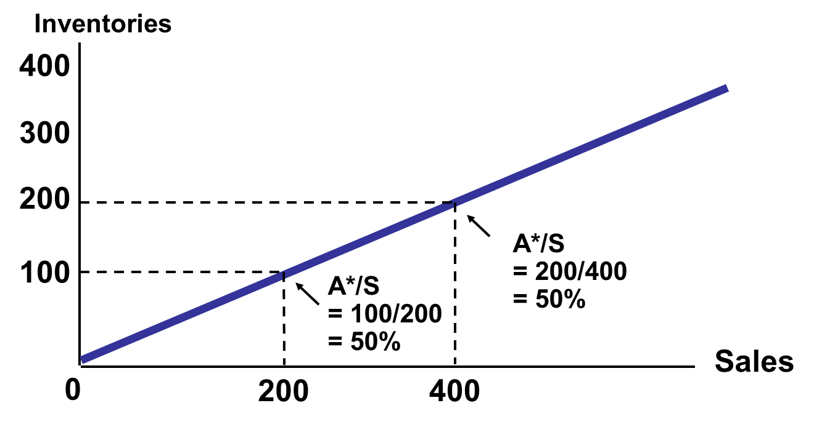
Possible Ratio Relationships: Constant A*/S Ratios

Slide 53
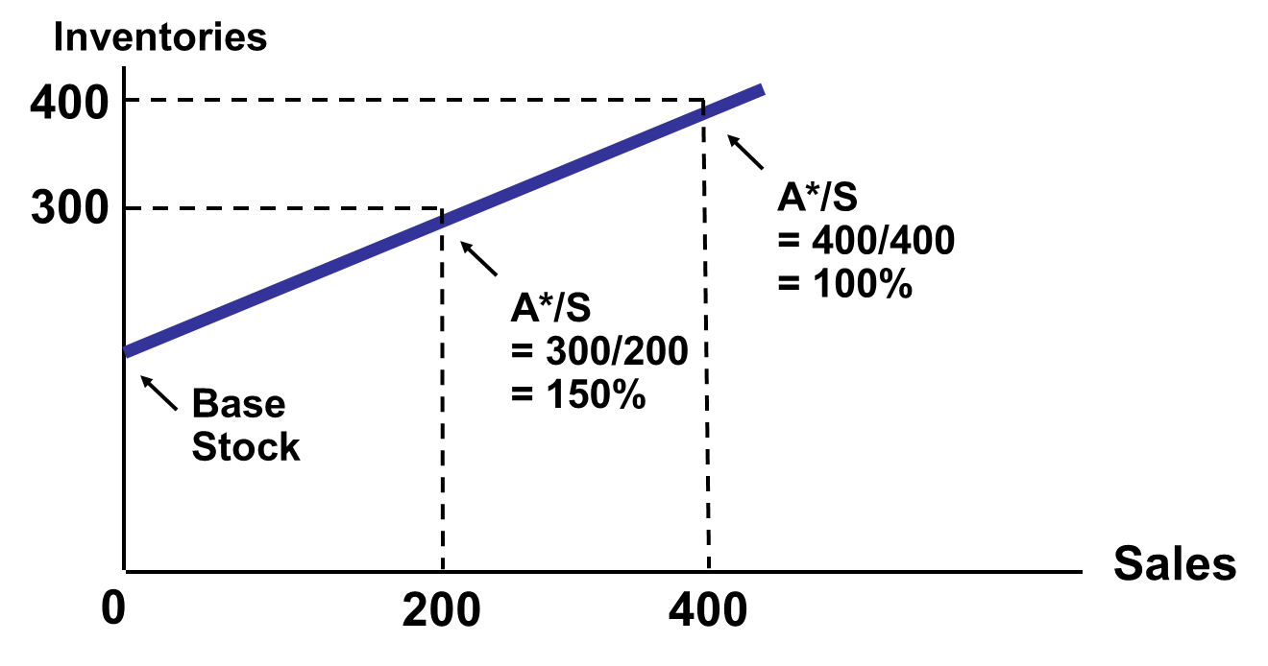
Economies of Scale in A*/S Ratios

Slide 54
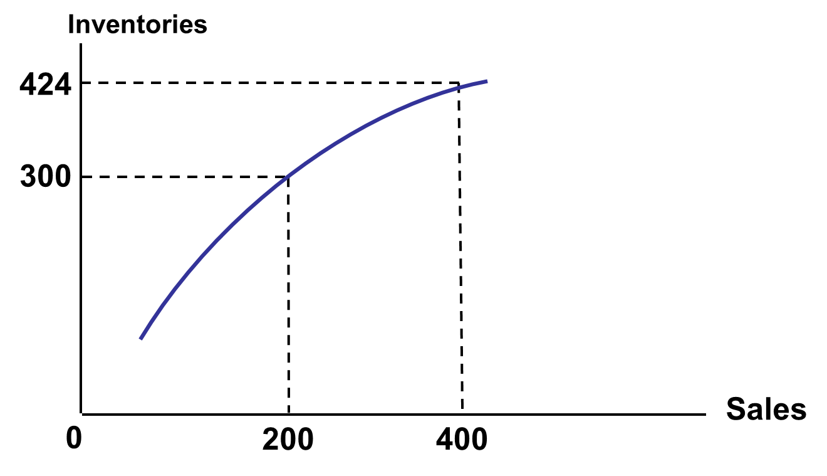
Nonlinear A*/S Ratios

Slide 55
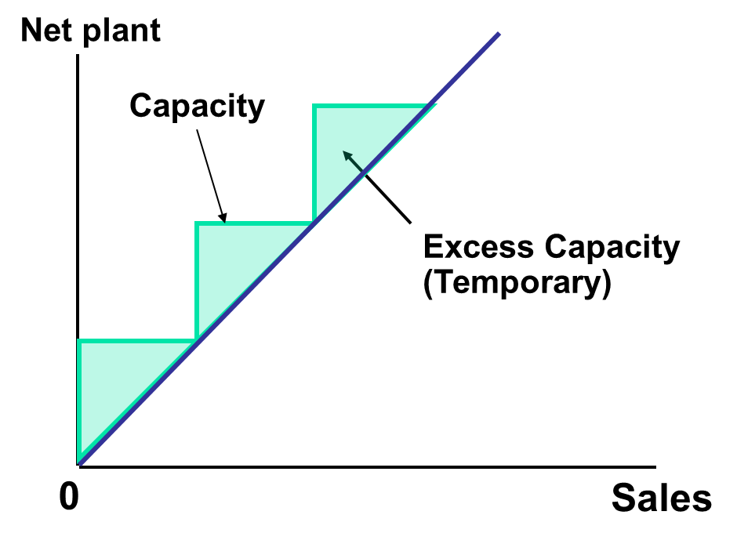
Possible Ratio Relationships: Lumpy Increments

